Slide 1
SHRI SHANKARACHARYA ENGINEERING COLLEGE
2019-2020
VOCATIONAL TRAINING
PRESENTATION ON:
BASICS OF JAVA PROGRAMMING
PRESENTED BY:
GUNJAN VISHWAKARMA
P.URMILA
ASHAWEE JOSHI
5TH SEM
COMPUTER SCIENCE &ENGINEERING
SEC-A

Slide 2
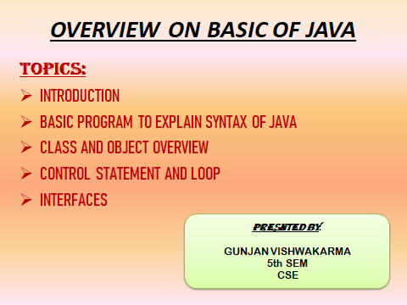

Slide 3
INTRODUCTION
Java is an general purpose ,object oriented programming language developed by SUN MICROSYSTEM of USA in 1991.
Basic concept of oops :
Abstraction.
Encapsulation.
Inheritance.
Polymorphism.
Why java is better than C++?
Everything should be class in Java. No global function. No global data. No structs, no union.
There is no scope resolution operator :: in java
No preprocessor like macros in java.
Primitive data types in java are guaranteed to be initialized in java.
No pointers.

Slide 4
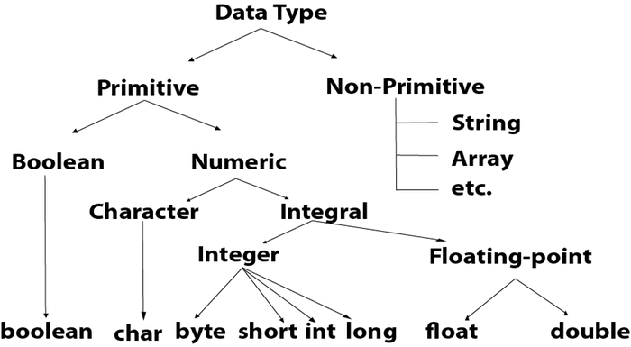
DATA TYPES
There are two types of data types in Java:
Primitive data types: The primitive data types include boolean, char, byte, short, int, long, float and double.
Non-primitive data types: The non-primitive data types include Classes, Interfaces, and Arrays.

Slide 5
PROGRAM TO EXPLAIN SYNTAX IN JAVA
HELLOWORLD (STANDALONE)
public class HelloWorld {
public static void main(String[] args)
{
system.out.println("Hello World!");
}
}
Note that String is built in
println is a member function for the
System.out class

Slide 6
CLASS AND OBJECT OVERVIEW
Class is synonymous with data type
Object is like a variable
The data type of the Object is some Class
referred to as an instance of a Class
CLASSES CONTAIN:
the implementation details of the data type
and the interface for programmers who just want to use the data type
Objects are complex variables
usually multiple pieces of internal data
various behaviors carried out via methods

Slide 7
CONTROL STATEMENT
linear flow of control
statements executed in consecutive order
Decision making with if - else statements
if(boolean-expression)
statement;
if(boolean-expression)
{ statement1;
statement2;
statement3;
}
A single statement could be replaced by a statement block, braces with 0 or more statements inside

Slide 8
if-else:
if(boolean-expression)
statement1;
else
statement2;
multiway selection:
if(boolean-expression1)
statement1;
else if(boolean-expression2)
statement2;
else
statement3;
individual statements could be replaced by a statement block, a set of braces with 0 or more statements
Java also has the switch statement, but not part of our subset

Slide 9
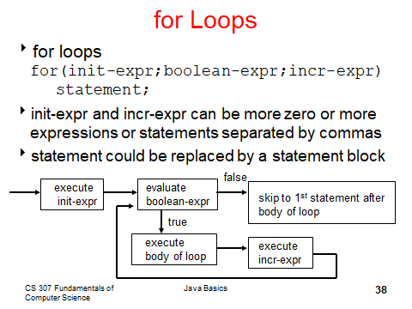
LOOPS

Slide 10
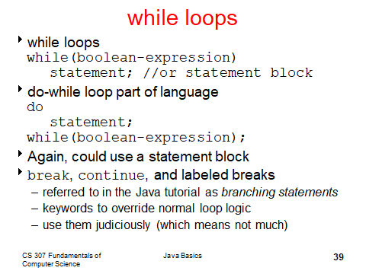
Note :
Goto statement cannot be used.

Slide 11
FOR AND EACH LOOP
class ForLoop {
public static void main(String[] args) {
char[] vowels = {'a', 'e', 'i', 'o', 'u'};
for (int i = 0; i < vowels.length; ++ i) {
System.out.println(vowels[i]);
}
}
} You can perform the same task using for-each loop as follows:
class AssignmentOperator {
public static void main(String[] args) {
char[] vowels = {'a', 'e', 'i', 'o', 'u'};
// foreach loop
for (char item: vowels) {
System.out.println(item);
}
}
}
Notes:
Enhance for loop
Traverse an array ,variable name item

Slide 12
Interfaces
Blue print of class
Mechanism to achieve abstraction
Methods in interface cannot be instantiated, it can only be declared
Implements multiple inheritance in Java
By default all methods in an interface are public.
An interface is declared by using keyword “interface”.
Syntax:
interface <interface_name>{
// declare constant fields
// declare methods that abstract
}
Notes:
1.To avoid ambiguity error java does not support multiple inheritance through class. But through the interface, multiple inheritance is possible in java. No java doesn't support multiple inheritance directly because it leads to overiding of methods when both extended class have a same method name.
2.Since interface is implemented by another class, so to inherit them and to implement those methods should be accessible by the class. And since we know only public methods are accessible so all the methods in an interface are public. Now the higher version of java we can have private methods and can also instantiate them.

Slide 13
interface printable{
void print();
}
interface coprint{
void print(int i);
}
class A6 implements printable, implements coprint {
public void print(){
System.out.println("Hello");
}
An abstract class allows you to create functionality that subclasses can implement or override. An interface only allows you to define functionality, not implement it. And whereas a class can extend only one abstract class, it can take advantage of multiple interfaces.
Notes:
Abstraction and interface difference between
A class that is extending abstract class should define abstract method
And may and may not define the non abstract method
Interfaces had to define all methods
No matter it is abstract ,non abstract or static or whatever

Slide 14
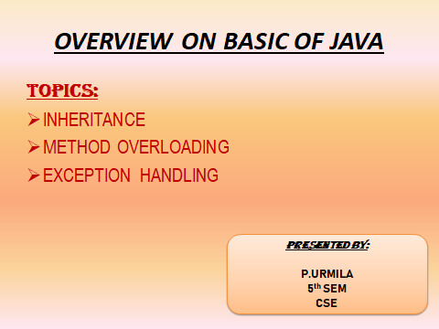

Slide 15
INHERITANCE
mechanism in which one class acquires all the properties and behaviours of a parent class
IS-A relationship which is also known as a parent-child relationship.
Why use inheritance in java?
Method overriding and code reusability
Syntax of Java inheritance
Example:
        class Subclass-name extends Superclass-name
        {
        //methods and fields
        }
extends keyword indicates that we a new class is made which is derived from an existing class
"extends" is to increase the functionality.
In multiple inheritance a class can inherit properties of more than one parent class. The problem occurs when there exist methods with same signature in both the super classes and subclass. On calling the method, the compiler cannot determine which class method to be called and even on calling which class method gets the priority .In order to avoid such complications Java does not support multiple inheritance of classes.

Slide 16
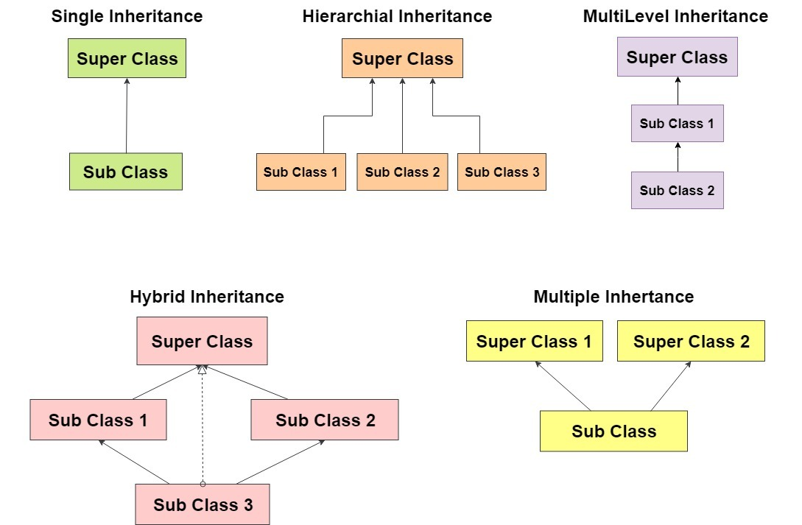
Single Inheritance example:
class Animal{
void eat(){System.out.println("eating...");} }
class Dog extends Animal{
void bark(){System.out.println("barking...");} }
Multilevel Inheritance example:
class Animal{
void eat(){System.out.println("eating...");}
}
class Dog extends Animal{
void bark(){System.out.println("barking...");}
}
class BabyDog extends Dog{
void weep(){System.out.println("weeping...");}
}
Types of Inheritance

Slide 17
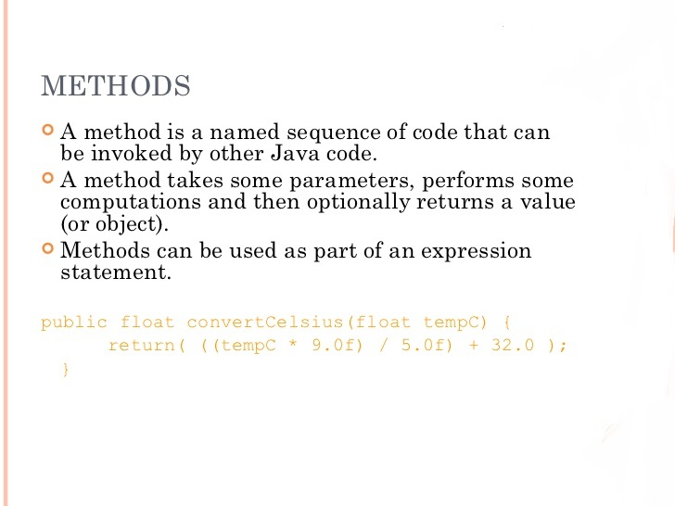

Slide 18
METHOD SIGNATURES
A metod signatures specifies:
Name of the method
Type and name of each parameter
Type of the value(or object) returned by the method
Various method modifiers.
Modifiers type name(parameter list)

Slide 19
METHOD
OVERLOADING Vs OVERIDING
METHOD OVERLOADING
METHOD OVERIDING
Method overloading is used to increase the readability of the program.
Method overloading is performed within class.
In case of method overloading, parameter must be different.
Method overloading is the example of compile time polymorphism
In java, method overloading can't be performed by changing return type of the method only.
Return type can be same or different in method overloading. But you must have to change the parameter.
Method overriding is used to provide the specific implementation of the method that is already provided by its super class.
Method overriding occurs in two classes that have IS-A (inheritance) relationship.
In case of method overriding, parameter must be same.
Method overriding is the example of run time polymorphism.
Return type must be same or covariant in method overriding.

Slide 20
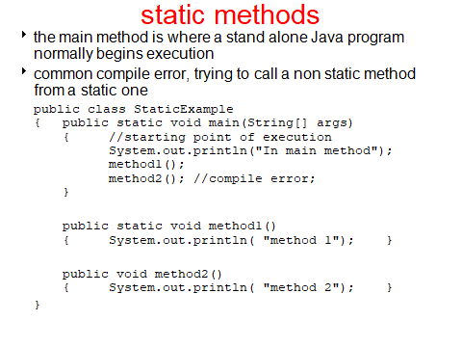

Slide 21
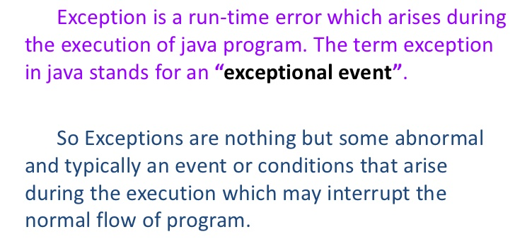
Exception Handling
Try-catch block is used for exception handling.
An additional block i.e. Finally block which contains all the crucial statements that must be executed whether exception occurs or not.

Slide 22
Exception handling using try-catch block
SYNTAX:
try{
//statement that may cause exception
} catch (exceptionName exp) {
//error handling code
} finally {
//statements to be executed
}
EXAMPLE:
Public static void main(String[] args) {
int[] arr={3,4,5,6};
try{
System.out.println(arr[23]);
} catch( ArrayIndexOutOfBoundsException exp) {
System.out.println(exp);
} finally {
System.ou.println(“end”);
}
}
OUTPUT: java.lang.ArayIndexOutOfBoundException:23
end

Slide 23
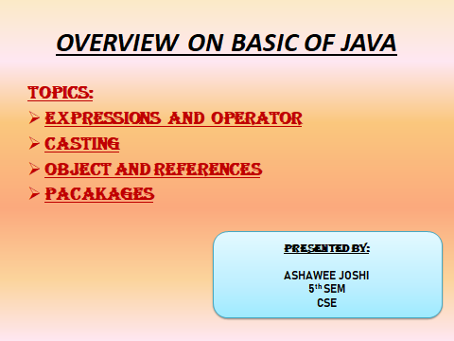

Slide 24
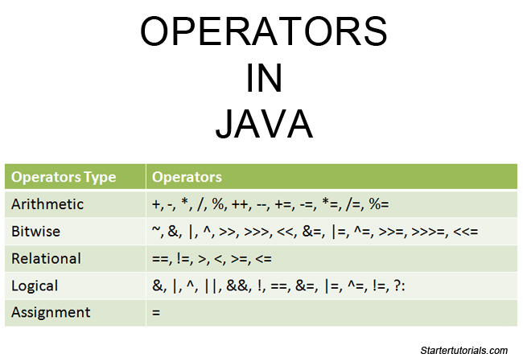
OPERATORS AND EXPRESSIONS
Basic Assignment: =
Arithmetic Operators: +, -, *, /, %(remainder)
integer, floating point, and mixed arithmetic and
expressions
Assignment Operators: +=, -=, *=, /=, %=
Increment and decrement operators: ++, --
Bitwise operator and logical operators.
prefix and postfix.
avoid use inside expressions.
int x = 3;
x++;

Slide 25
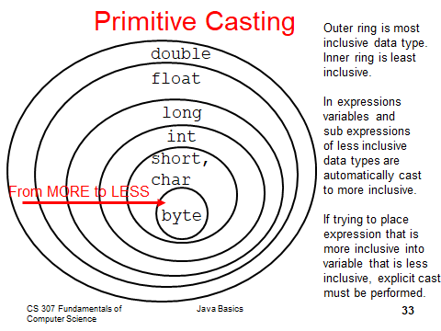
CASTING
Casting is the temporary conversion of a variable from its original data type to some other data type.
With primitive data types if a cast is necessary from a less
inclusive data type to a more inclusive data type it is done
automatically.
int x = 5;
double a = 3.5;
double b = a * x + a / x;
double c = x / 2;
failure to do so results in a compile error.
double a = 3.5, b = 2.7;
int y = (int) a / (int) b;
y = (int)( a / b );
y = (int) a / b; //syntax error

Slide 26
OBJECT AND REFERENCES
What is difference between references and objects in java? A reference is an entity which provides a way to access object of its type. An object is an entity which provides a way to access the members of it's class or type. Generally, You can't access an object without a reference to it

Slide 27
PACKAGES
It is another implementation of encapsulation
mechanism to encapsulate a group of classes, sub packages and interfaces
Uses of packages:
Preventing naming conflicts.
Making searching/locating and usage of classes , interfaces, easier
Providing controlled access
Packages can be considered as data encapsulation
(or data-hiding).

Slide 28
HOW PACKAGES WORK?
Package names and directory structure are closely related. For example if a package name
is college.staff.cse, then there are three
directories, college, staff and cse such that cse is
present in staff and staff is present college. Also,
the directory college is accessible
through CLASSPATH variable, i.e., path of parent
directory of college is present in CLASSPATH.

Slide 29
THANK YOU

